Slide 1


VISVESVARAYA TECHNOLOGICAL UNIVERSITY, BELAGAVI
“SIXTH SENSE TECHNOLOGY
Presented by
Apoorva C 4YG18CS001
Under the guidance of
Dr.Myna A N BE, MTech, PhD..
DEPARTMENT OF COMPUTER SCIENCE AND ENGINEERING
NAVKIS COLLEGE OF ENGINEERING, HASSAN
2021-22

Slide 2
CONTENTS
1. Abstract
2. Introduction
3. Components Used
4.Working
5.Applications
6. Advantages
7.References
8.Conclusion

Slide 3
ABSTRACT
Sixth Sense Technology integrates digital information into the physical world.
The Sixth Sense device recognizes the objects around us and displays the information relating to those objects in a real time environment.
It can turn any surface into a touch-screen for computing, controlled by simple hand gestures.
It supports multi touch and multi user interactions.
It has the potential to form the transparent user interface for accessing the information around us.

Slide 4
INTRODUCTION
Sixth Sense technology is a technology with which a system could be trained to recognize real world objects and react as desired.
This technology bringing intangible ,digital information into the tangible world, and allowing us to interact with this information via natural hand gestures.
Sixth Sense technology which immediately traces the whole information about an object as soon as we see it.
The technology is mainly based on hand gesture recognition, image capturing, processing and manipulation.
The software of the technology uses the video stream, which is captured by the camera , and also tracks the location of the tips of the fingers to recognize the gestures.
Sixth Sense/WUW(wear UR world) which is wearable gestural, user friendly interface which links the physical world around us with digital information.

Slide 5
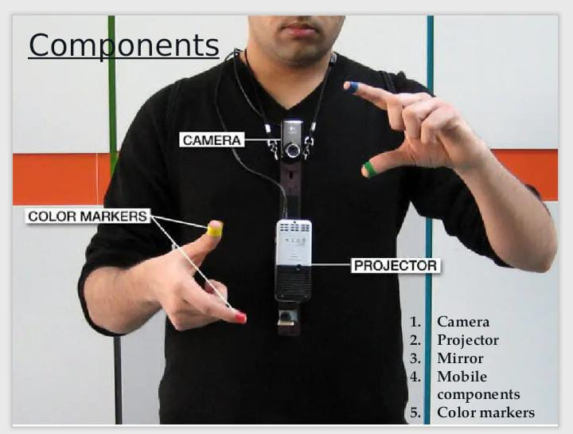
COMPONENTES USED :
The hardware components are coupled in a pendent like mobile wearable device.
Fig 1: Components of the pendent

Slide 6
CONT…
Camera :
Camera captures an object in view and tracks the user’s hand gestures.
It sends the data to smart phone
Acts as a digital eye which connects to the outside world in the digital format.
Smart Phone :
The smart phone acts as a interpreter between all hardware components camera, projector etc.
Smart Phone run the sixth sense software and handles all the processing and the connection to the internet.

Slide 7
CONT…
Projector :
The data that is processed by the software is anticipated on any surface.
The projector projects visual information enabling surfaces, walls and physical objects around us to be used as interfaces.
Mirror :
Mirror reflects the image on to the desired surface.
Colour caps /markers :
Coloured markers is placed at the tip of the user’s fingers using simple computer vision techniques.
It helps the camera to track the movement of fingers.
The movement of these makers are interpreted into gestures that acts as interaction instructions for the projected application interfaces.

Slide 8
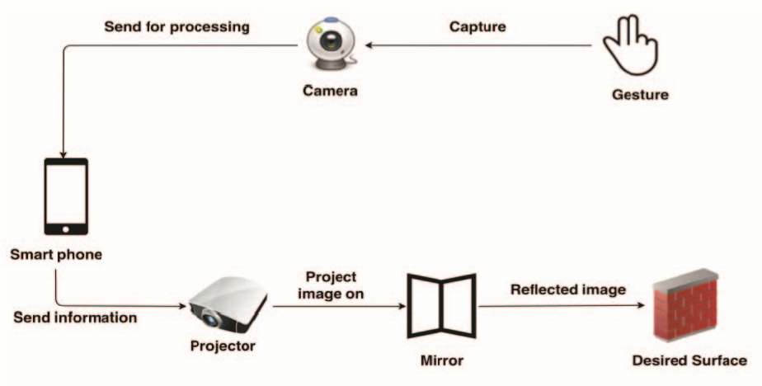
WORKING :
The Sixth Sense device is pendent like wearable device.
Fig 2: working of sixth sense device

Slide 9
WORKING CONT….
Camera captures the gestures one makes with their hands
Information is sent to the Smartphone for processing
The downward facing projector projects the output image on to the mirror.
Mirror reflects the image on to the desired surface.
Thus, digital information is freed from its confines and placed in the physical world

Slide 10
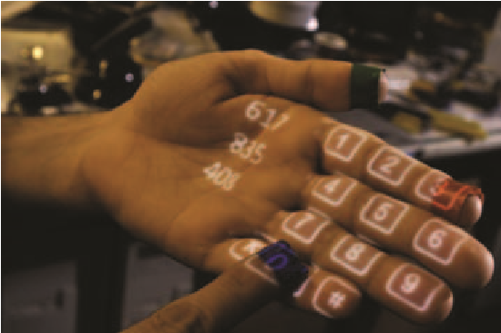
APPLICATIONS
Calculator :
We can use sixth sense to project a key pad onto your hand.
Then we use that virtual keypad to calculate values.
Fig 3: Make a Calculator

Slide 11
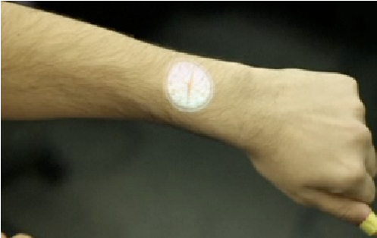
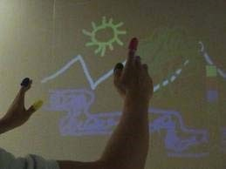
CONT….
Check time :
Check time , by drawing circle on wrist, then projector will project watch on wrist.
Fig 4: check time on wrist
Drawing application :
Draw a picture on any desired surface just by moving the index finger in the air.
Fig 5:Drawing using gesture recognition technology

Slide 12
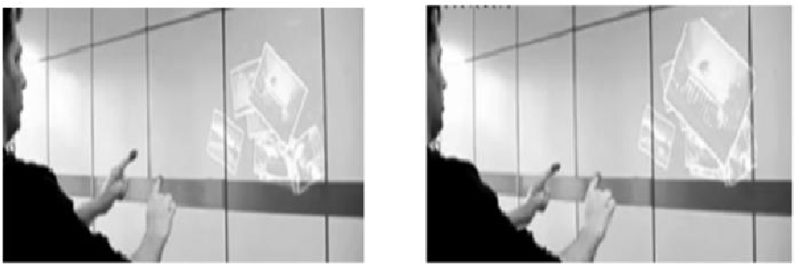
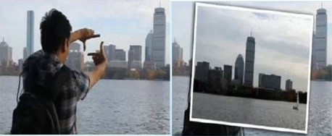
CONT…
Zooming features :
We can zoom in and out by hand gestures by pinching fingers of both hands to zoom in and make both hand closer to each other to zoom.
Fig 6: zoom in and out
Take Pictures :
Take a picture just by making photo frame or rectangle by fingers.
The photo will be taken and it will be placed in smart phone.
Fig 7: Taking Pictures

Slide 13
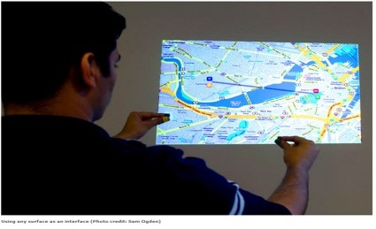
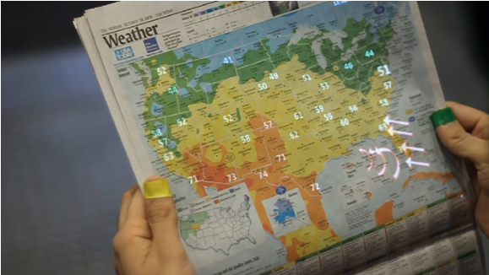
CONT…
Viewing Maps :
We can view Maps and also navigate.
Fig 8: Viewing maps
Viewing Weather information :
We can also view the current days Weather information just by showing map on paper or any surface to the camera.
The Weather information is searched from the internet by the smart phone.
Fig 9 :Weather information

Slide 14
ADVANTAGES
It is easy to carry the device.
It supports multi-user interaction.
Easily affordable.
Data can be accessed in the real world , helps us in making right decisions.
It acts as a computer as well as saves our time searching information on the internet.
It is a wearable gesture based device which can turn any surface an meaningful presentation.
This device can be used by anybody, even the one who don’t know how to use a computer.

Slide 15
CONCLUSION
Sixth sense technology recognizes the objects around us and makes us interact with the information in anyway we need without the use of microelectronic gadgets.
Sixth sense technology clearly became a transparent user interface thus making life easier.
The sixth sense prototype implements the several applications that demonstrate the usefulness, viability and flexibility of the system.

Slide 16
REFERENCES
[1] Bathani Raksha K, “Sixth Sense Technology OR WUW (Wear Ur World)” ,volume - 2, Issue -2 , June 2012.
[2] Meenakshi Gupta ,Shruthi Sharma, “ Virtual Class room using Sixth Sense Technology”, volume - 6, Issue - 4, Sep- Oct 2012
[3] Monika Arora , “Basic Principles of Sixth Sense Technology” ,volume-2,Issue- 8, 2012

Slide 17
THANK YOU

